Slide 1
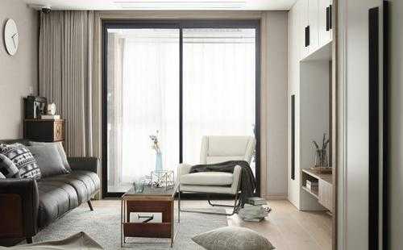
Scenario : Home

Slide 2
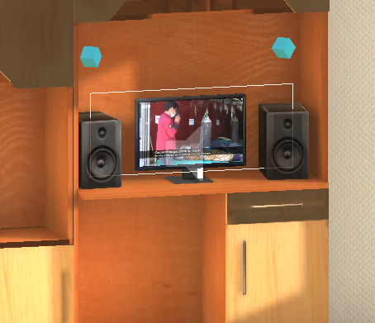
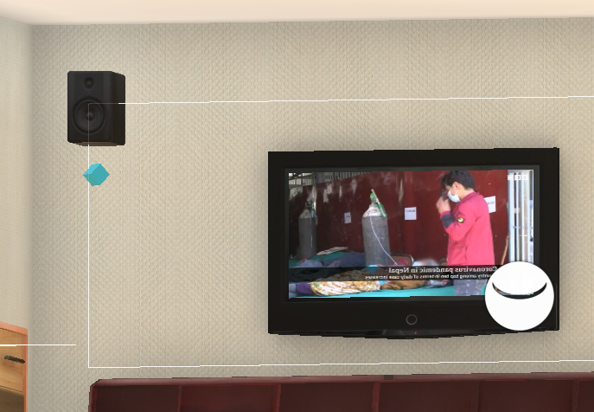
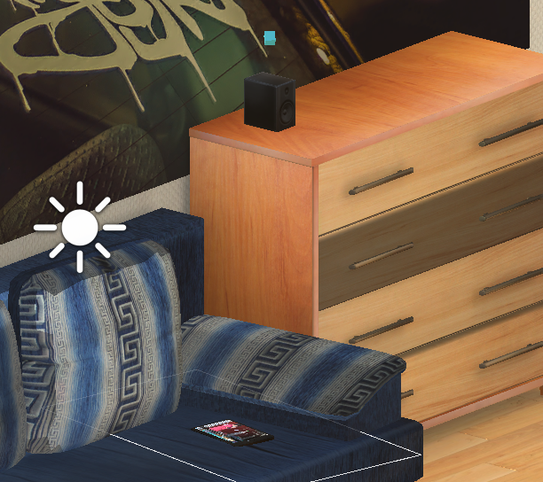
Location-based Intelligent news-playing
Notes:
In home scene, we usually have a variety of video sources like phone/pad/TV/PC and audio sources like stereos and the video sources themselves that distributed across the room. We want to make use of all of these video audio sources, to make the news listening and viewing experience more consistent and fluent.

Slide 3
Implement
Transform of voice output between audio sources
Transform of visual output between video sources
Update the distances between the user (camera) and all the video/audio sources
Active the nearest video/audio source

Slide 4
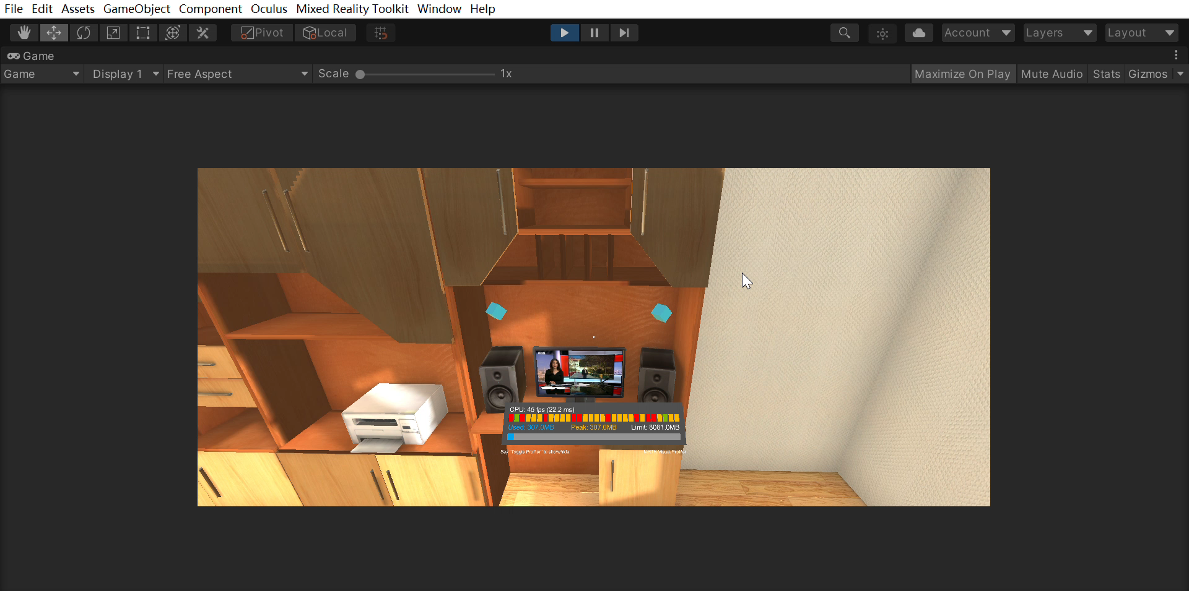
Demo

Slide 5
Problems
Transform of visual content should take eye tracking target into account
Give different kinds of devices different weights when calculating distances

Slide 6
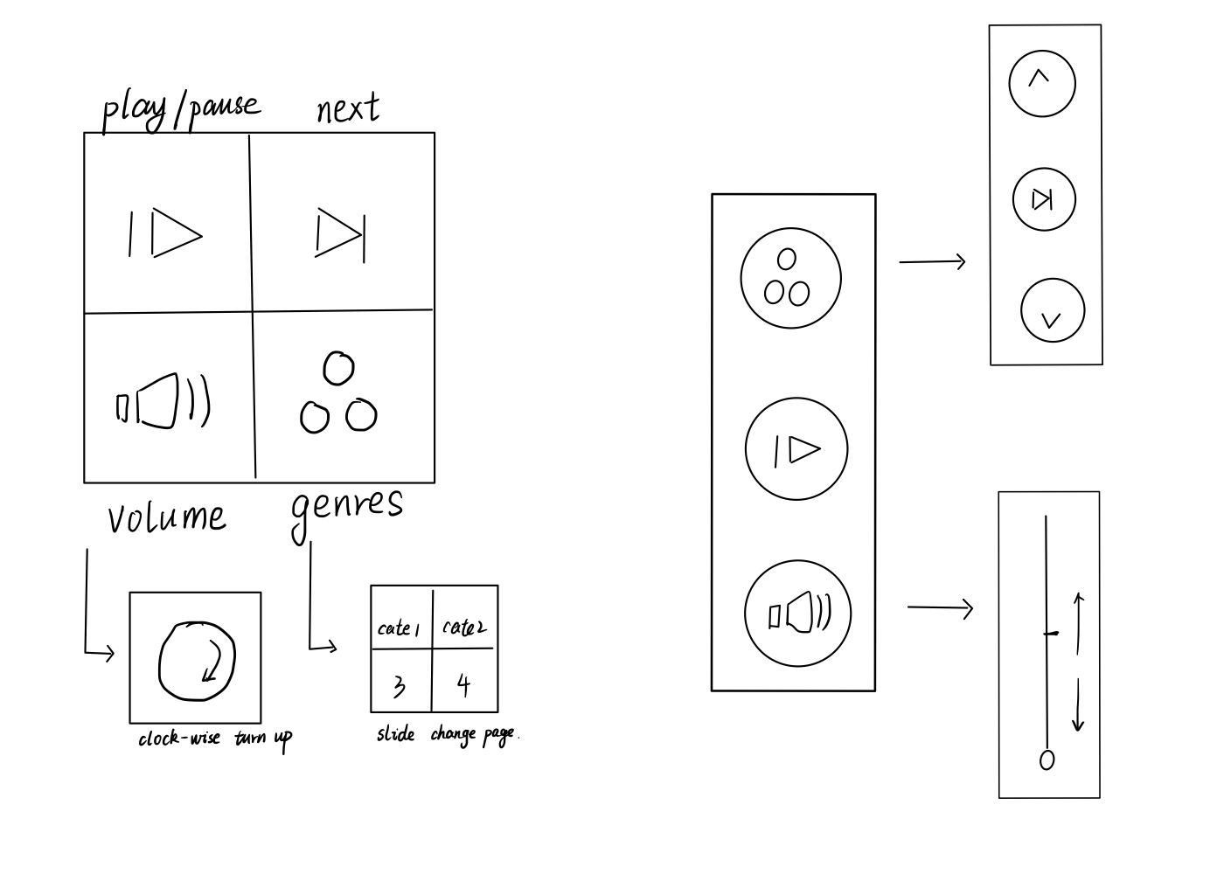
Remote control using smartwatch and smartphone

Slide 7
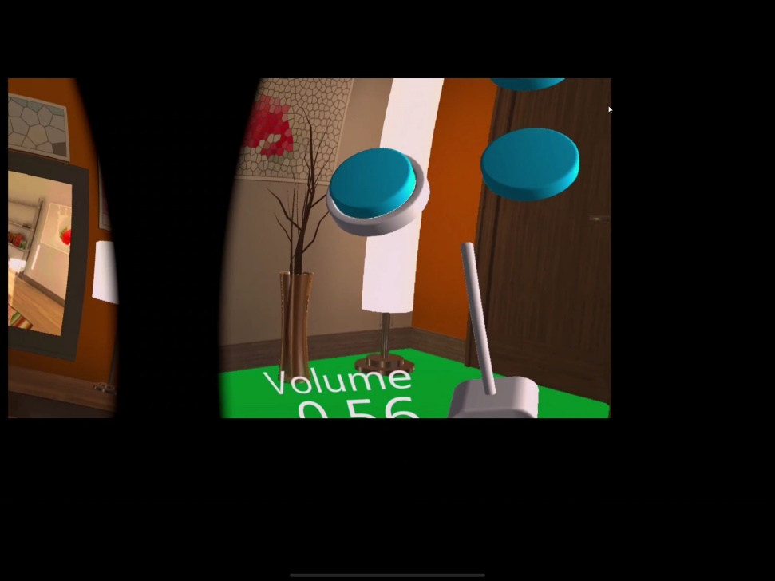
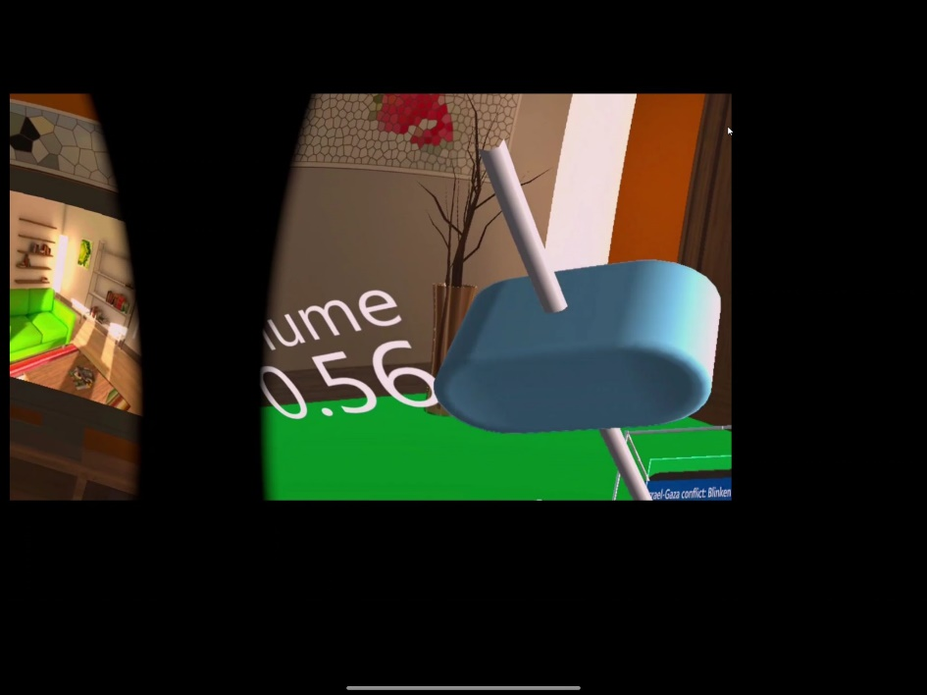
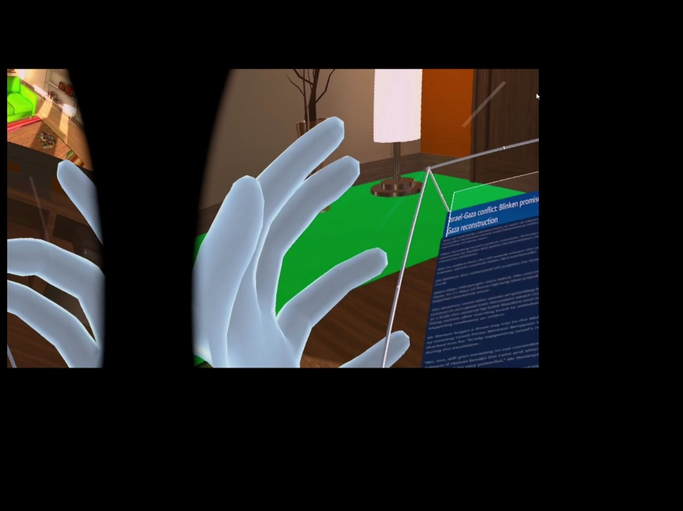
Remote control using smartwatch and smartphone
Interactive UIs: button(touch), slider(grab), scrolling the screen(scroll)

Slide 8
Problems
Make the UIs more delicate
Increase the accuracy of gesture

Slide 9
Todo
Car scenario: voice commands
UWP is not supported for Android platform
Use PC to do the speech recognition and send the speech recognition result to Oculus quest through openHAB

